Slide 1


Funding for Research

Slide 2
Sources
  The supervisor’s research funds
  As part of a programme of research (research entities)
  Departmental/School funds
  Your own funds from RINC
  Faculty derived funds
  URC funds
  NHLS Research Trust funds administered by MRC
  SA Statutory Bodies MRC/NRF
  Other SA agencies and industries
  Overseas funding

Slide 3
Own or supervisor’s funds
Research Incentive Funds
  R10,000/R20,000 per article, divided by number of authors
  For each DoHE accredited publication (list of accredited SA journals and all ISI listed journals)
  No letters, simple case reports, editorials, current opinions, reviews
  Must ensure all articles are uploaded on Wits system so they get claimed in the year in which the articles are published
  Funds can be rolled over, but be careful. Not for ever.

Slide 4
Faculty Individual Grants
Usually applications called for once a year (applications in by end of January)
Medical Faculty Research Endowment Fund (R330,000)
FRC Individual Grants (R600,000)
  Must spend funding within the funding year (by October)
  Not for computers, programmes, travel between hospitals, statistics, conferences/courses, preparation of dissertations and theses, research assistance
  For postgraduate students (Masters R5,000; PhD R8,000)
  New staff members (lecturer/researcher and above) and young researchers (3 or less years post PhD) (R10,000)

Slide 5
Faculty - discipline specific
Griffiths Trust (cancer research)
Connective tissue disorders
Iris Ellen Hodges CVS and Stress

Slide 6
Faculty Research Office
Minor Equipment (URC)
  R25,000 – R300,000
  Matching funds may be provided if non available from applicant
Major Equipment (URC and NRF)
  >R300,000
  URC provides matching funding, but must be supported by Faculty
Emerging researchers (seed funding)
New staff funds
Open access publication funds
  Depends on IF. Maximum R18,000
Conference travel (only emerging researchers)
  Overseas and local (only 1 conference/year)
  Must publish data from presentation before applying again

Slide 7
University Research Committee
Postdoctoral Fellowships (2-3 years)
Contact Dr Rob Drennan -
Director, DVC (Research And Post Graduate Affairs)
Robin.Drennan@wits.ac.za

Slide 8
Medical Research Council
Self-initiated Research Grants (SIR)
Amount awarded max. R200,000/annum for 3 years
SA Citizens of permanent residents
Permanent employment or long-term contract in University/Joint appointment
Postgrad students cannot apply
Must have ethics committee approval when application submitted
Applications go first to University and then to MRC (closing date for Univ May, MRC Aug last year)
Website describes the evaluation process and what is considered. Reviewed by 3 external assessors and the MRC Grants Committee.
http://www.mrc.ac.za/funding/university.htm

Slide 9
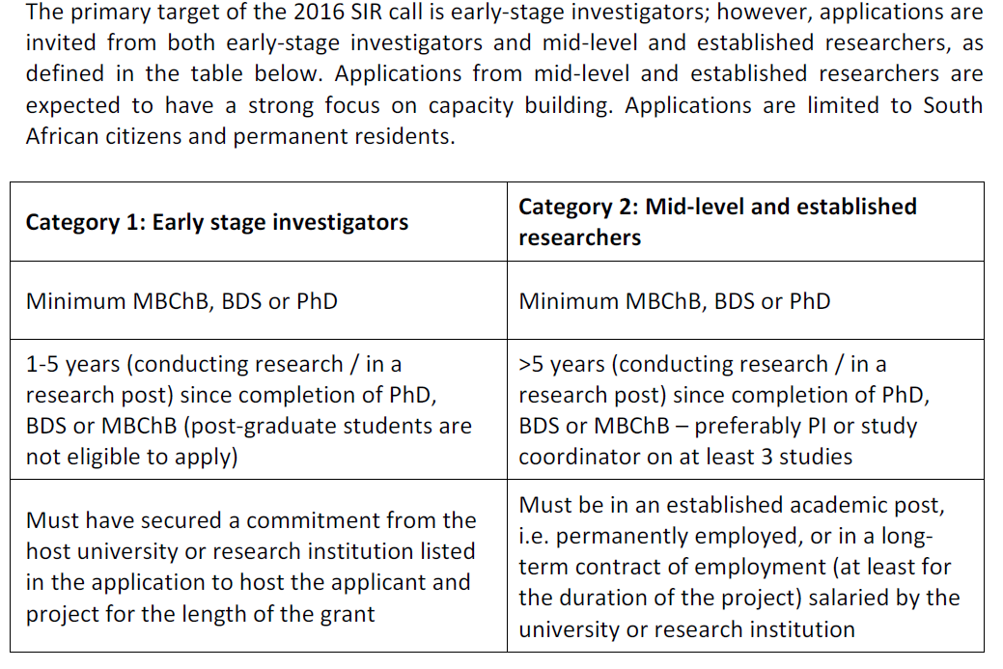
MRC SIR grants
Closing date for applications 28 September 2018

Slide 10
NRF
Thuthuka
  Supports the development of black female researchers or those with disabilities (<45 years)
  Three tracks
    PhD Post PhD
    NRF rating track
  Funding for maximum of 9 years
http://www.nrf.ac.za/funding_overview.php?fid=127

Slide 11
Other sources
Pharmaceutical industry
Tshikululu Social Investments http://www.tshikululu.org.za
  Administers a number of funds including Anglo American Chairman’s Fund, Discovery Fund
Nestle Foundation www.nestlefoundation.org/e/research.html
Bill & Melinda Gates Foundation
http://www.dhet.gov.za/internationalScholarships/
http://ec.europa.eu/programmes/erasmus-plus/index_en.htm

Slide 12

Research Connect
International
https://search.researchconnect.eu/
Username: Your Wits email address (this includes @wits, @nhls, @nicd, @wrhi etc.)
Password: Wits2019

Slide 13
Cost recovery
25% of all funds received, deducted
  10% to the Faculty
  15% to the School and should be retuned to you by the school
funds not attracting cost recovery include the NRF and MRC
All other funds must be negotiated with central University Committee eg NIH 8%
If funds are placed in WHC, approx 8% admin fee and VAT is added.

Slide 14
How to apply for funds
The Faculty does have grant writing courses
Don’t be sloppy
Answer all questions – do what is asked
Sell your project

